Slide 1
Predict Lending Club Loan Default Rate
Min XIAO
2018-03-16

Slide 2
Outline
Goal and Business Value
Data Exploration
Model Building
Model Comparison and Improvement
Conclusion

Slide 3
Goal and Business Value
Goal:
Build a model to predict default rate for lending club loan dataset
Business Value:
Identify loans with high probability to turn default so lending club can take actions to prevent those loans from becoming default
Lending club can use this model to assist decision making on loan applications
Help investigators to pick good loans with more confidence than random picking

Slide 4
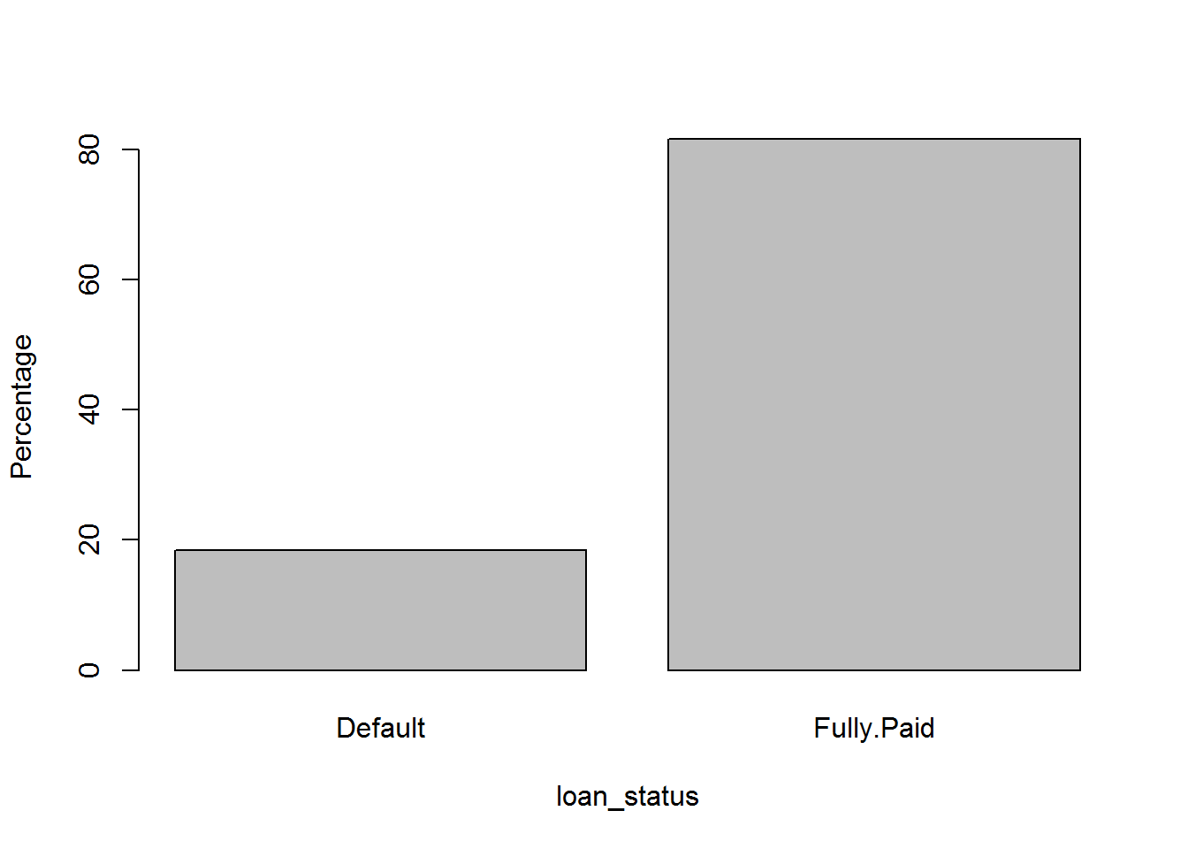
Data Exploration - response
Define response:
loans in "Default", "Charged Off", "Fully Paid" status are used.
Factorize loan_status to a two level feature, which is our response.
Response variable analysis:
The data is moderately imbalanced. It is okay to process without any rebalance work.

Slide 5
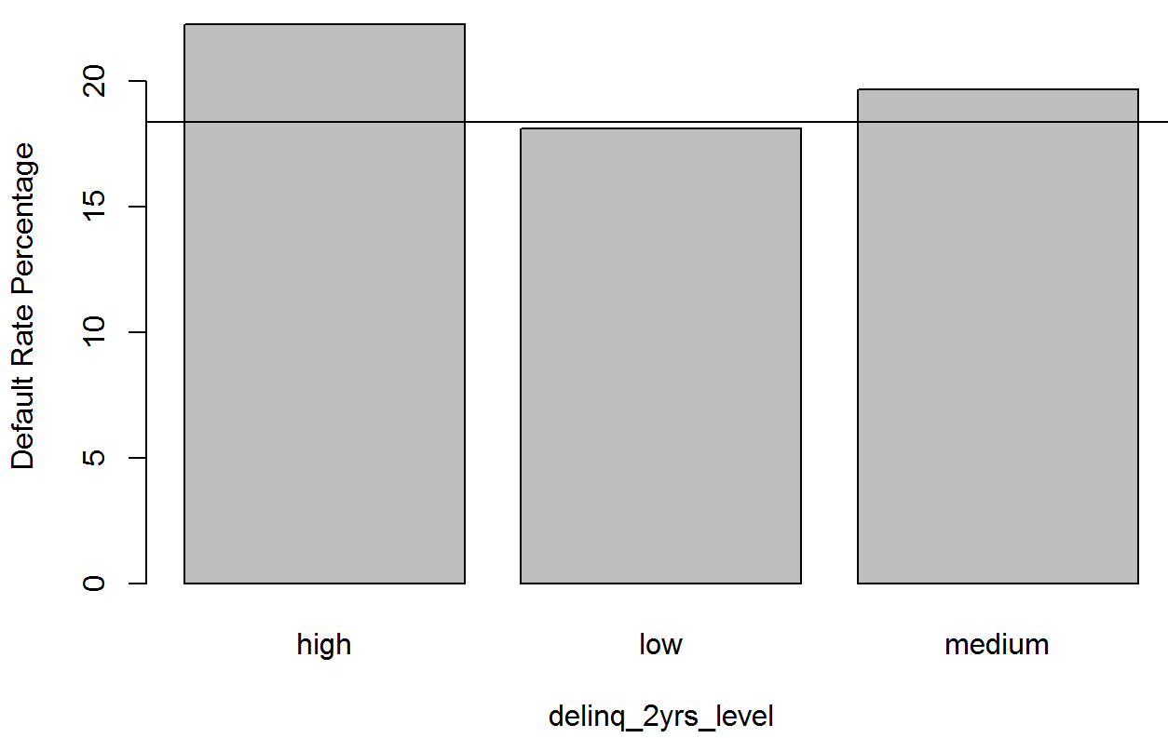
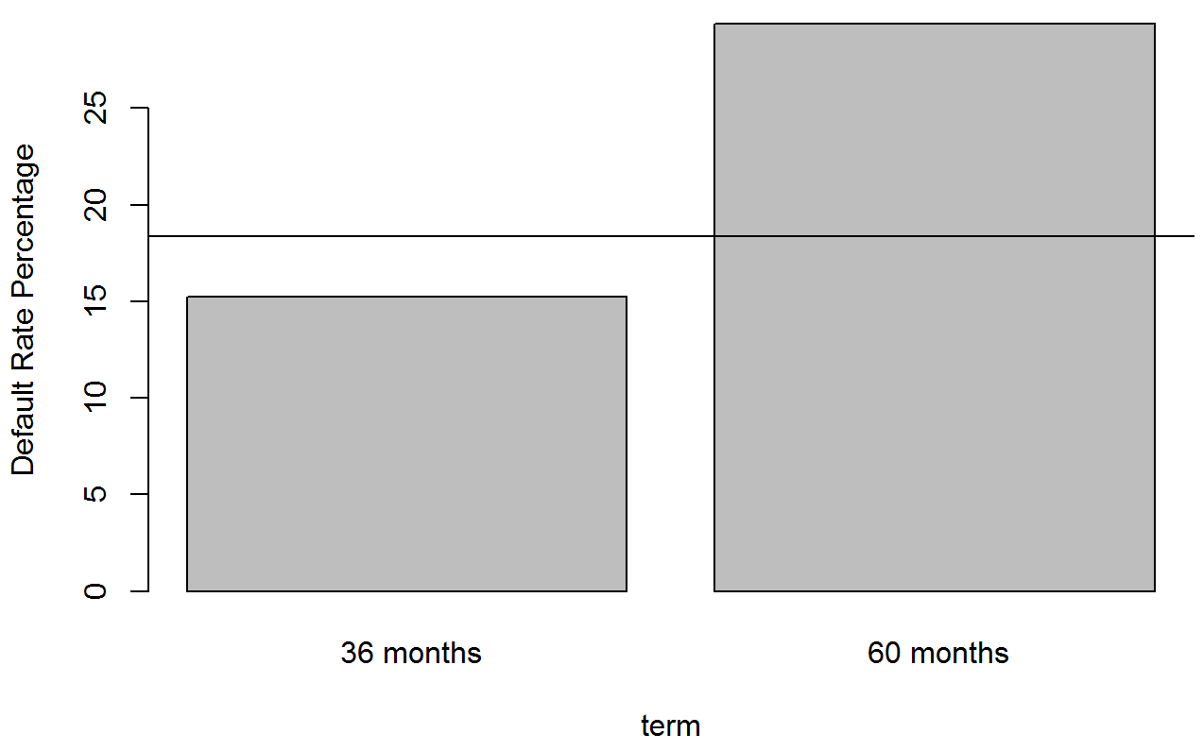
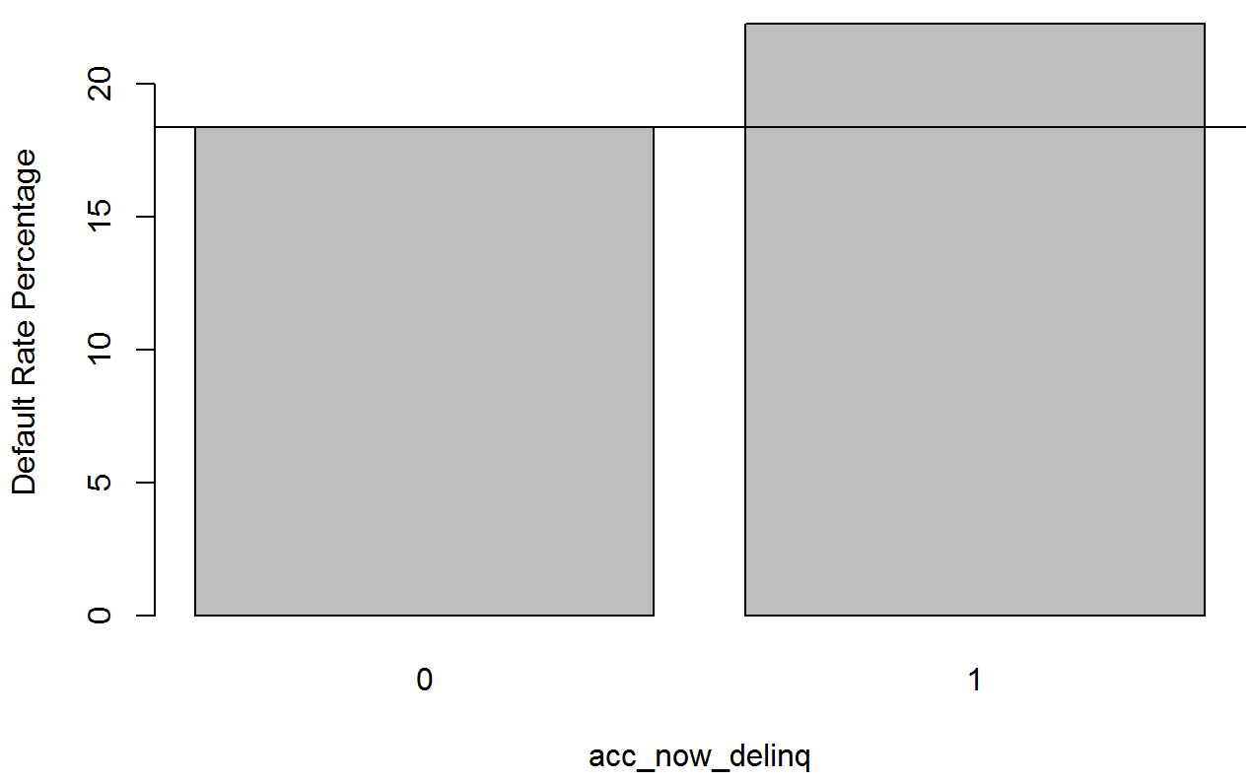
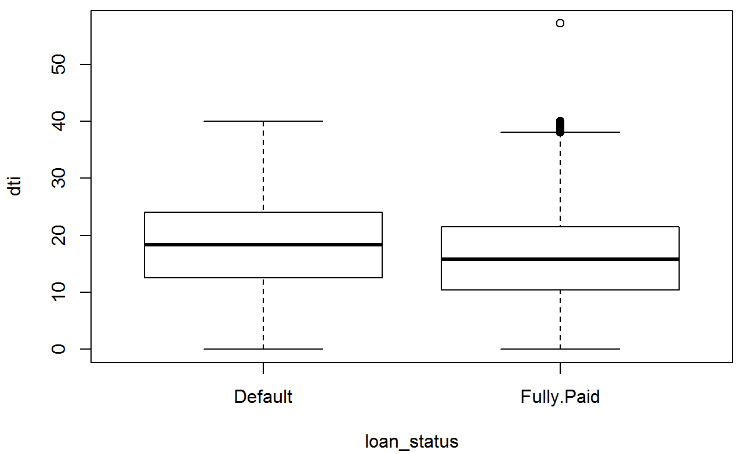
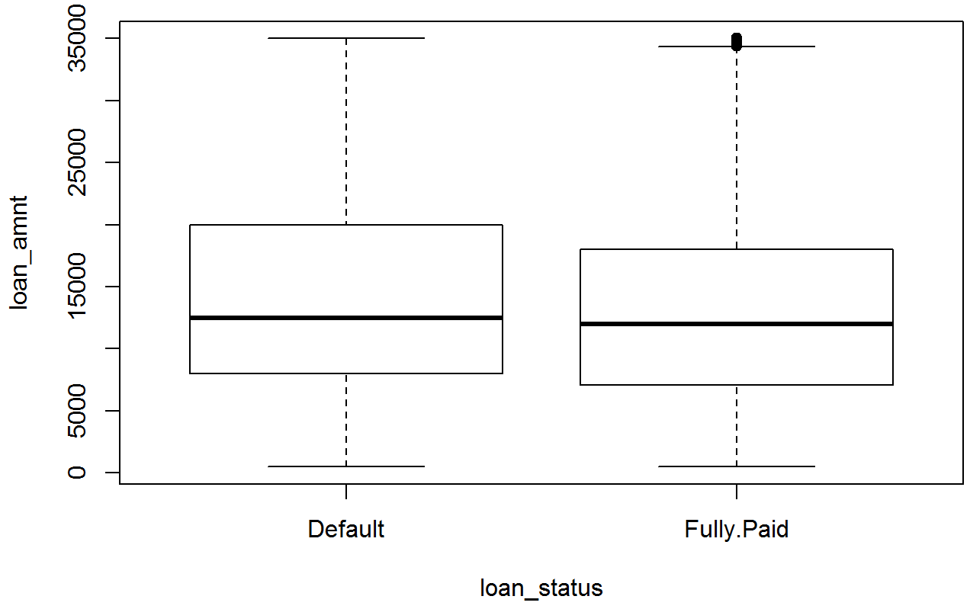
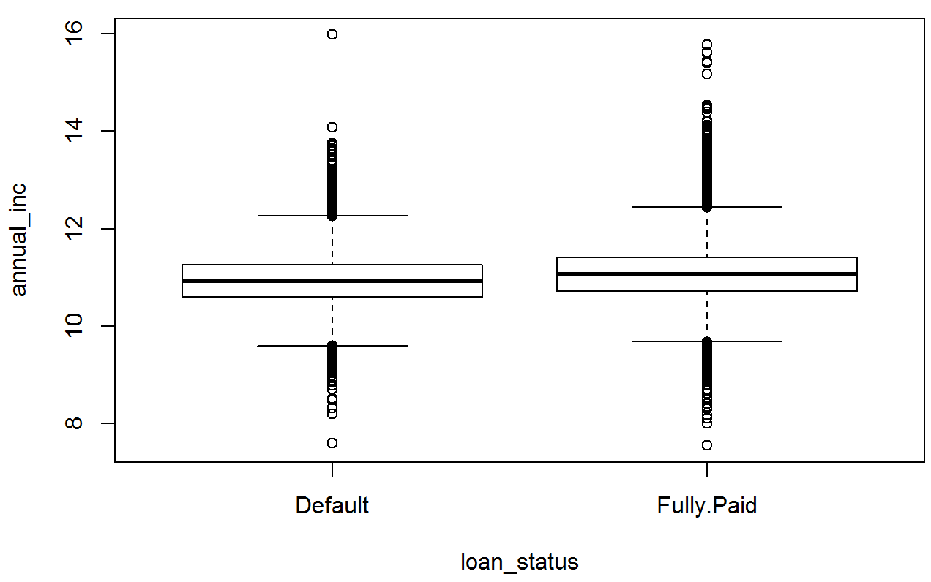
Data Exploration – variables with response
Strong Predictors:
delinq_2yrs_level
term
acc_now_delinq
dti
loan_amnt
annual_inc
Notes:
Selected features (22):
'loan_status','addr_state', 'emp_length', 'home_ownership', 'annual_inc', 'verification_status', 'dti', 'inq_last_6mths', 'total_acc', 'tot_cur_bal', 'open_acc', 'acc_now_delinq', 'delinq_2yrs', 'collections_12_mths_ex_med', 'pub_rec', 'revol_bal', 'revol_util','total_rev_hi_lim', 'purpose', 'term', 'initial_list_status', 'loan_amnt'

Slide 6
Feature Engineering
Do binning to reduce categorical feature levels
i.e. addr_state, emp_length
Convert numeric features with very few unique values into categorical features
i.e. inq_last_6mths, delinq_2yrs, collections_12_mths_ex_med
Take log for large spread numeric features
i.e. annual_inc, tot_cur_bal, revol_bal

Slide 7
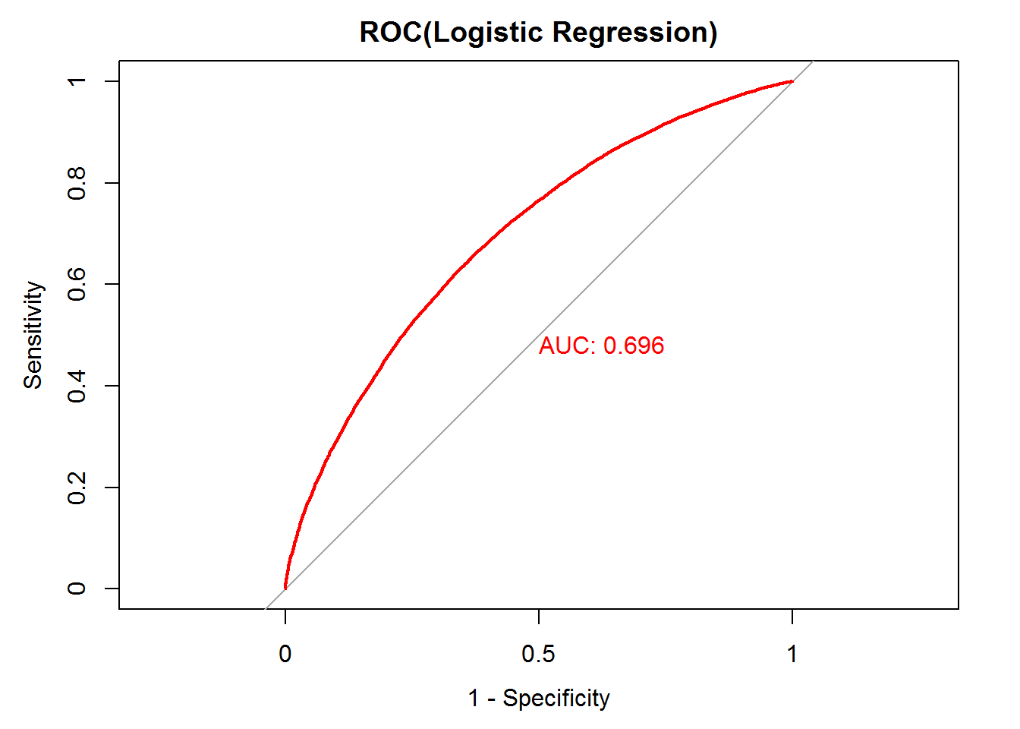
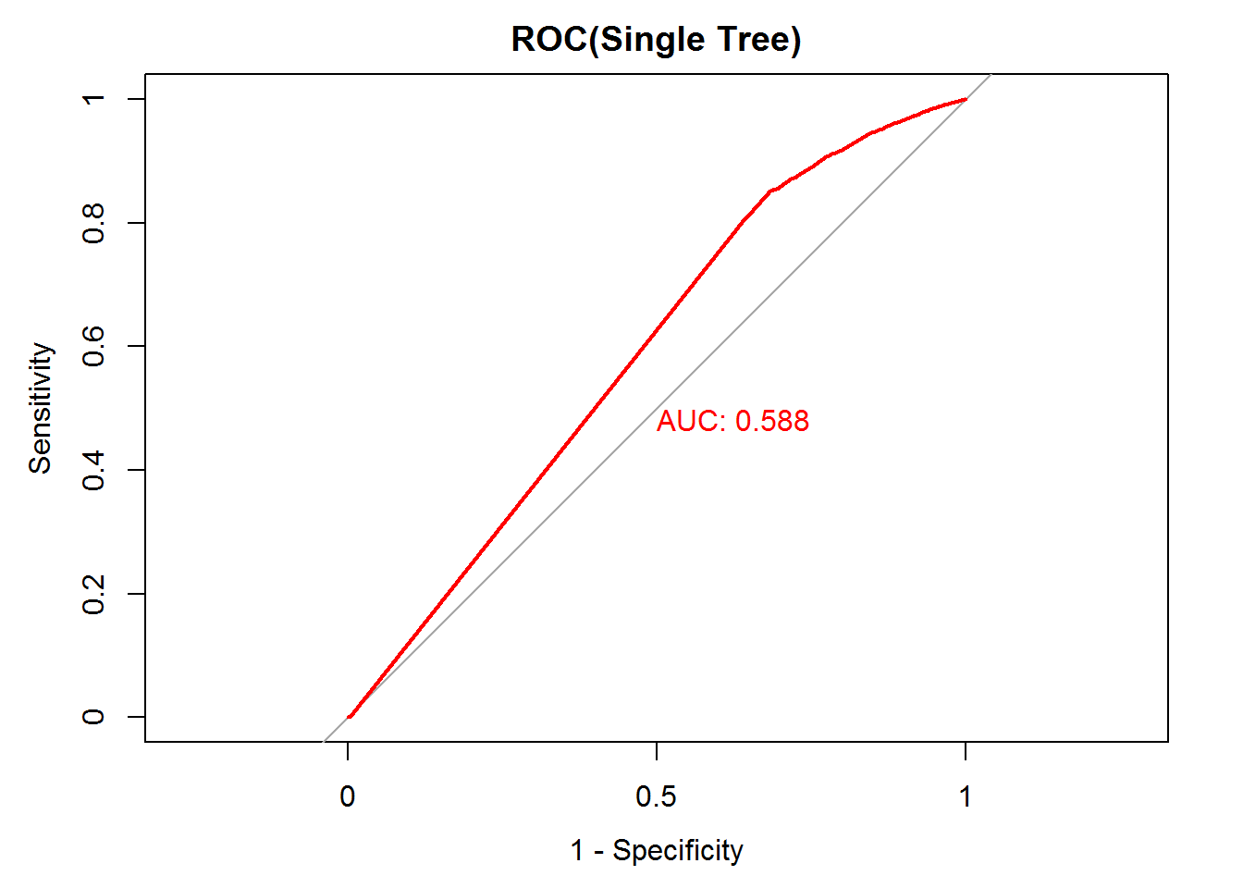
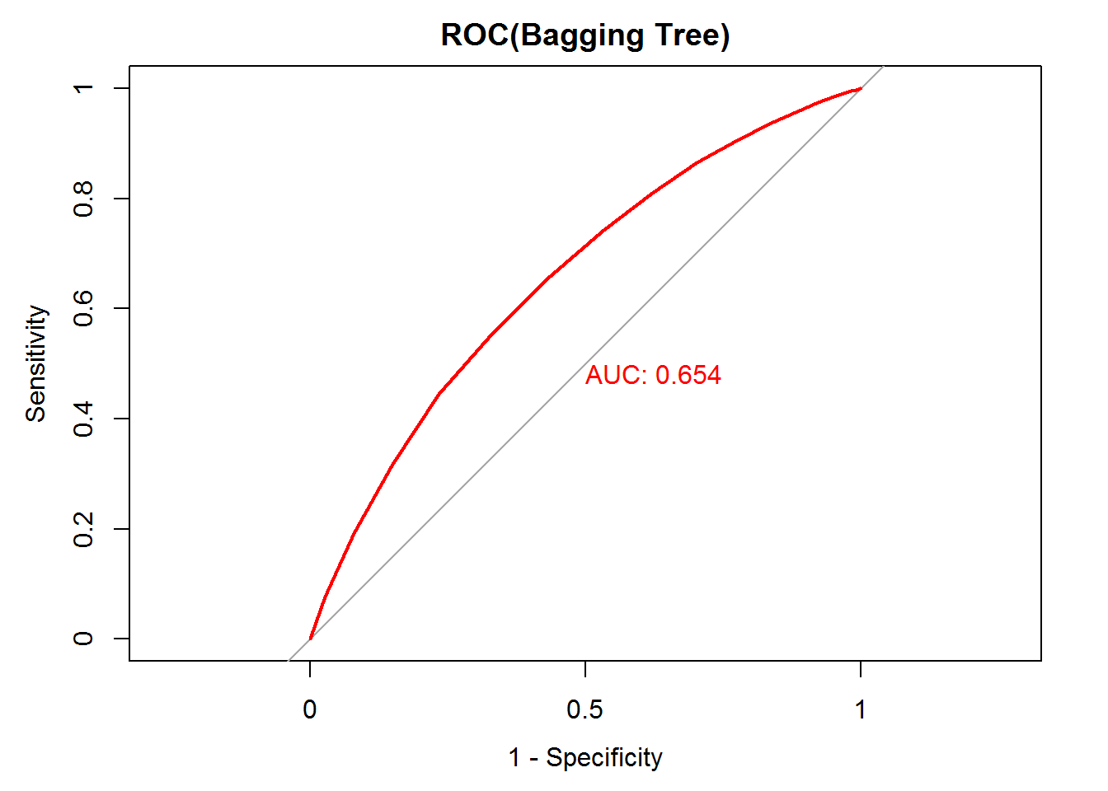


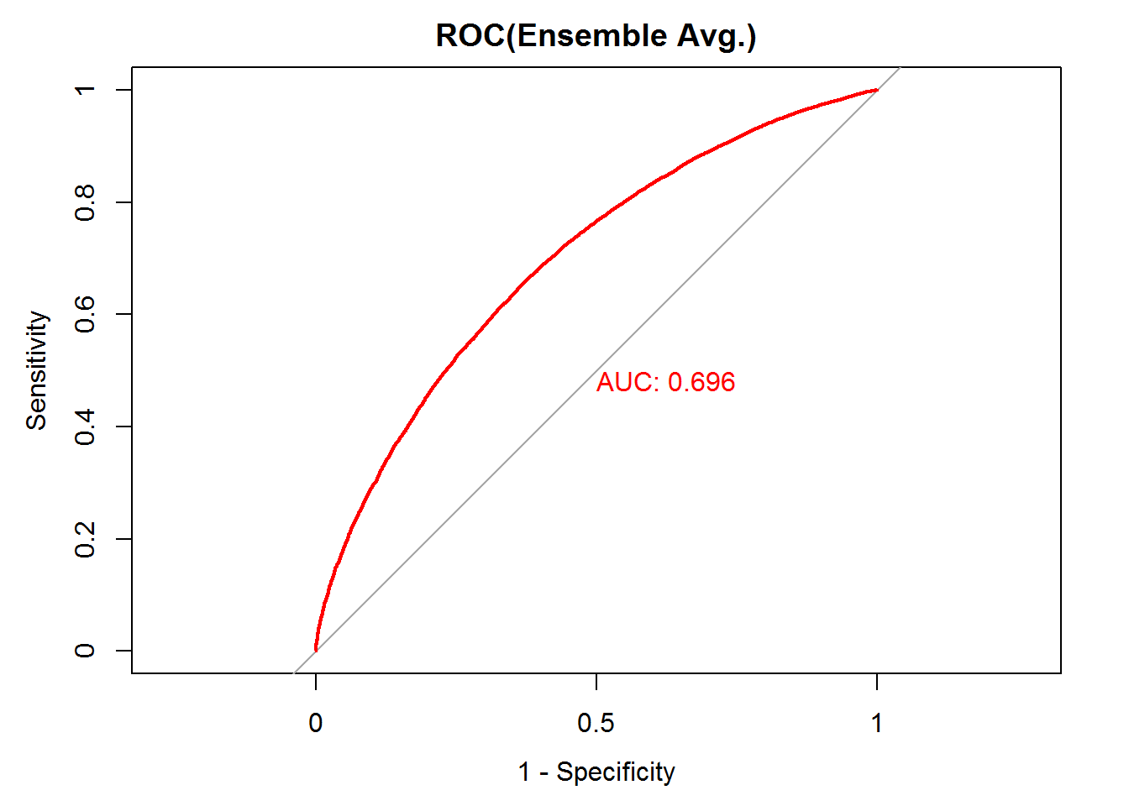
Model Building

Slide 8
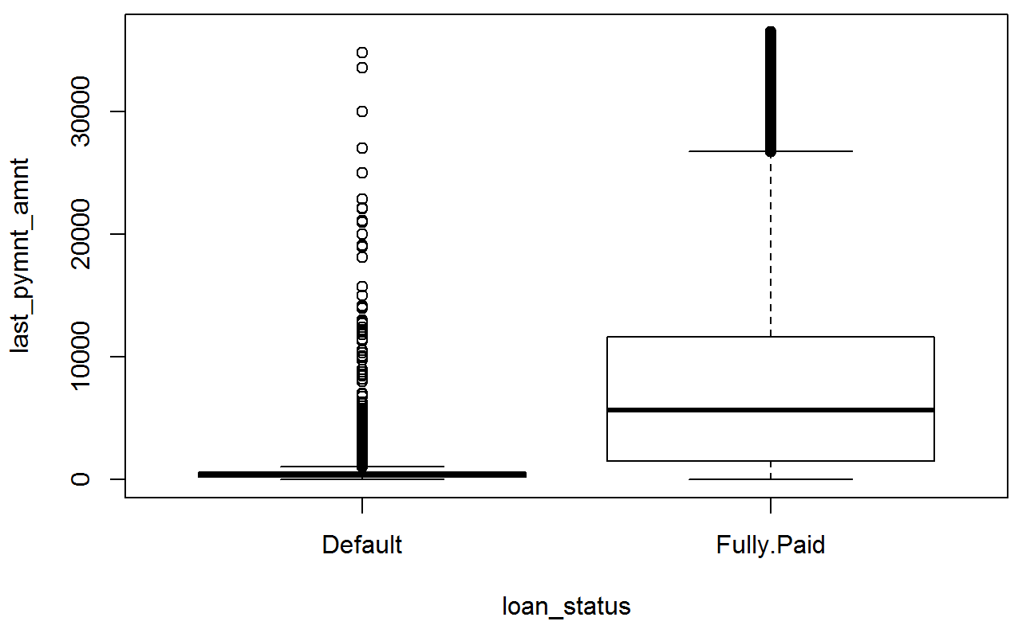
Model Comparison and Improvement
Model Performance on Test Dataset
Add new feature: last_pymnt_amnt
No | Model | AUC
1 | logistic regression | 0.696
2 | Single Tree | 0.588
3 | Bagging Tree | 0.654
4 | Random Forest | 0.575
5 | XGB | 0.685
6 | Ensemble | 0.696
In the initial trials, the AUCs are all below 0.7, which is a little low. Among them, logistic regression seems to perform best.
?? May be a too strong predictor

Slide 9
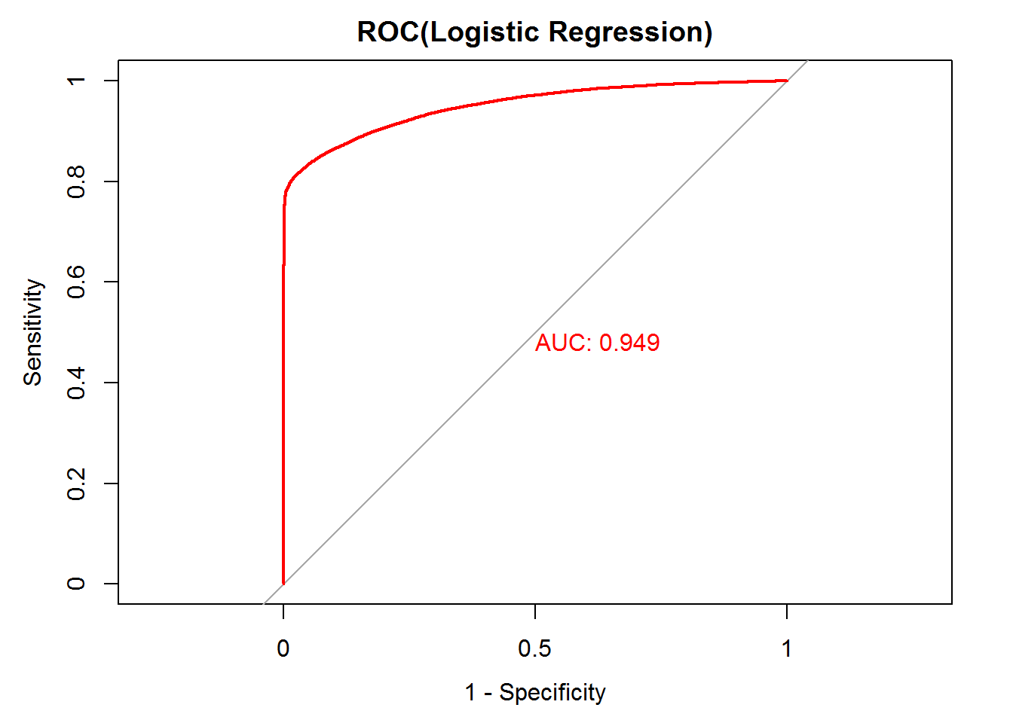
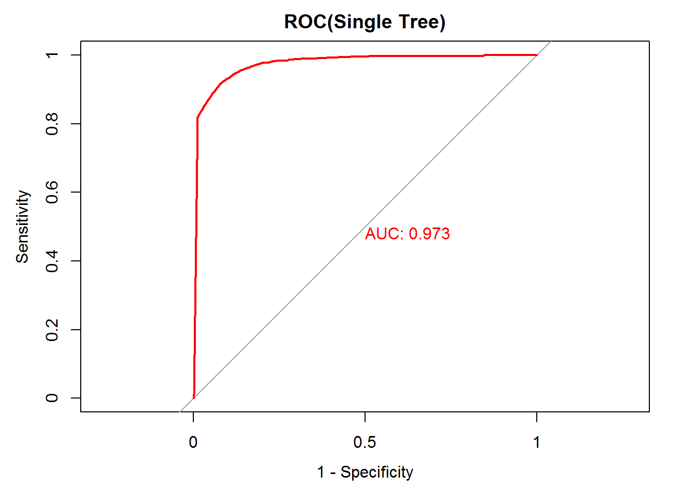
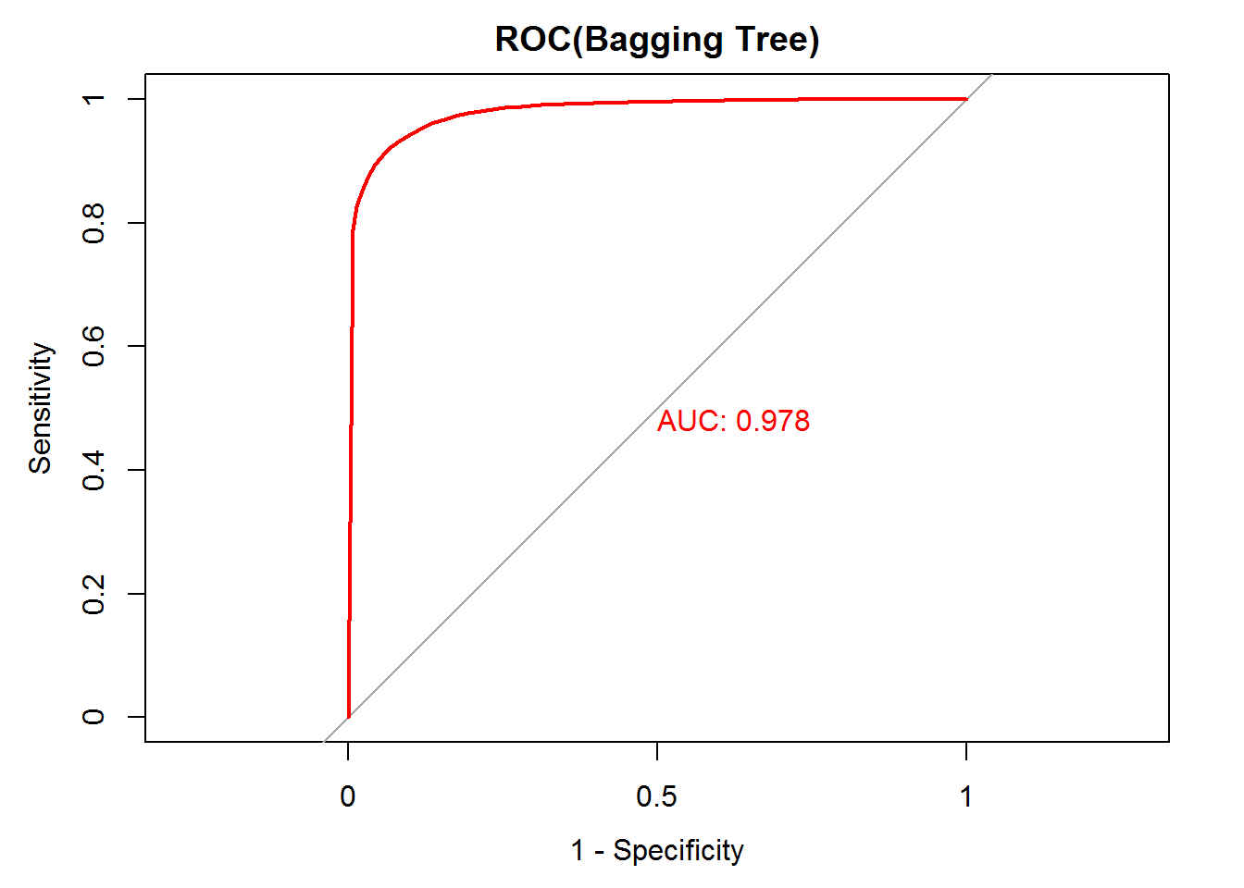
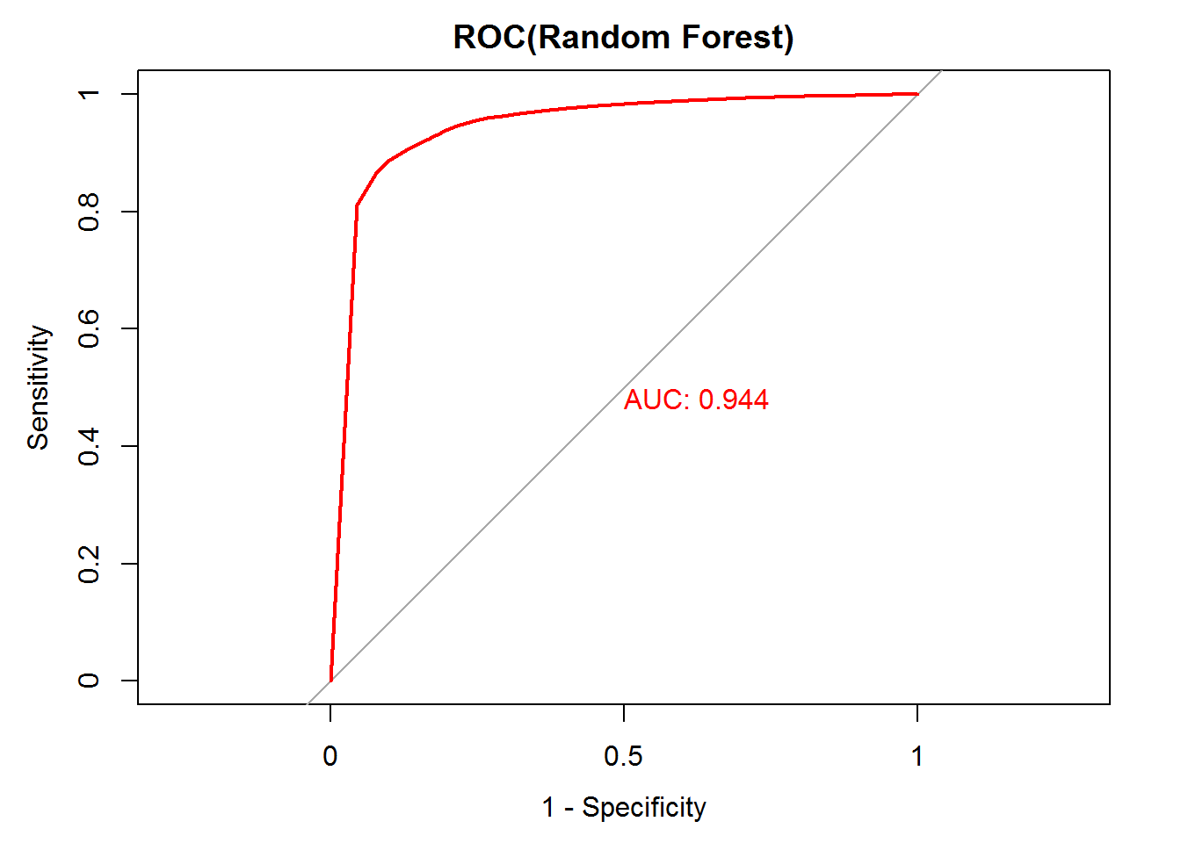
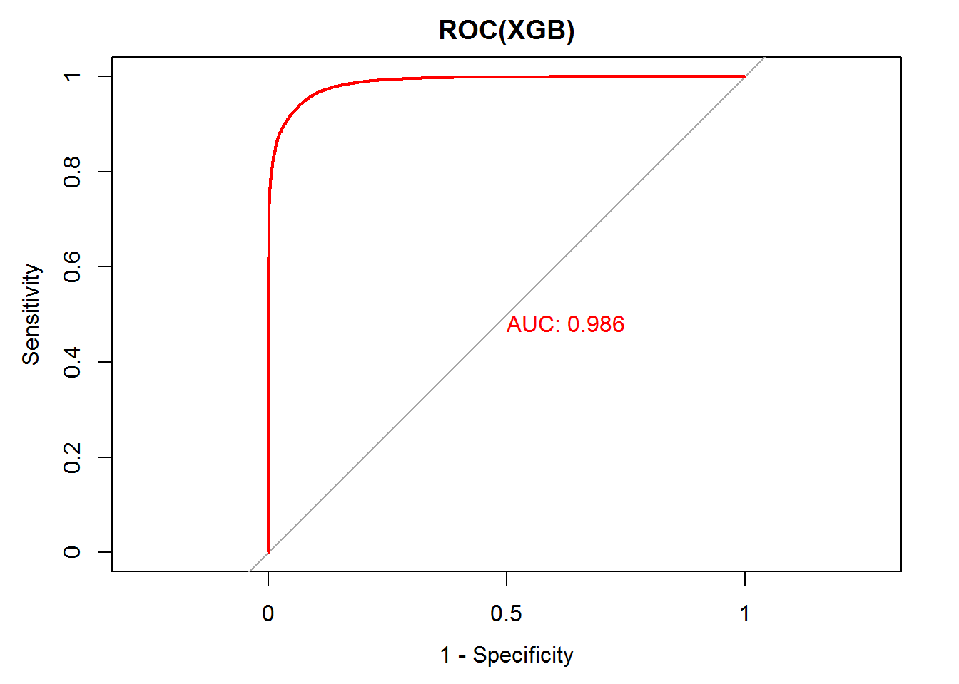
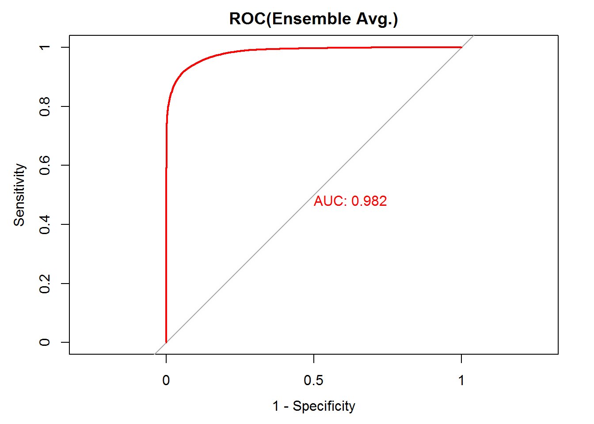
Model Building

Slide 10
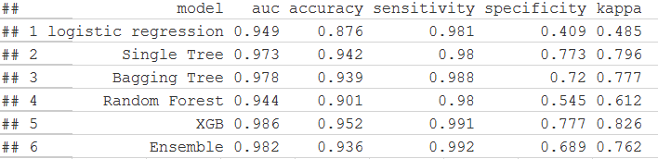
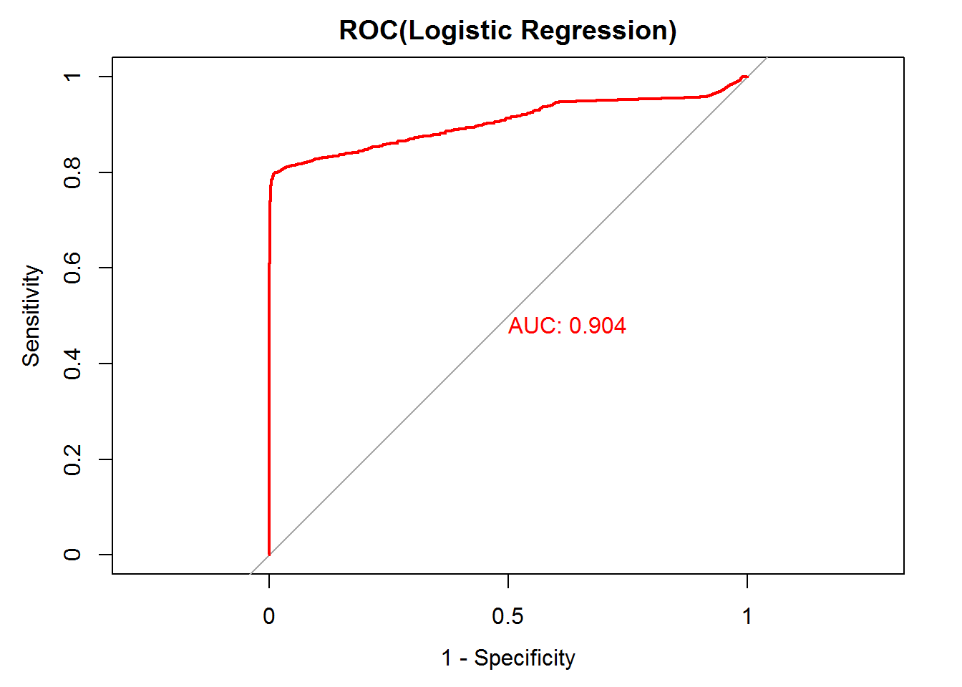
Model Comparison
Thoughts: Why all models improve so much?
Again, is it a too strong predictor, should we use it in our models.
Did a logistic model on that feature itself
formula <- loan_status ~ last_pymnt_amnt_to_loan_amnt_percent

Slide 11
Conclusion
Six different models of logistic regression, decision tree, bagging, random forest, boosting, and average ensemble were built, evaluated and compared.
Logistic regression model gives a reasonable performance in determining good loans from bad loans compared with other models.
Considering the simplicity and Interpretability of logistic regression, we recommend it as model of choice for predicting lending club loan dataset default rate.
Possible future work directions include: 1) dig hidden pattern info in payment related time series info 2) use the generated model to predict loans in current status and follow up.

Slide 12
Thank you !

